Slide 1
Sentiment analysis for EPARs

Slide 2
Agenda
Analysis
Assumptions
Approach
Results
Productionalization
Architecture
Process of productionalization
Deployment
Monitoring

Slide 3
Questions
Is the dataset balanced?
Is the amount of data sufficient for allowing a hold-out dataset?
Do you have enough data to consider deep neural architectures or might good feature engineering with more shallow models suffice?
During the data collection process, for some sentences multiple experts disagreed on the sentiment of a given sentence, how could you capture such an ambiguity in your model and potentially notify users about such unclear instances?
How does your model come to a specific conclusion, what about model interpretability?
Think beyond the pure sentiment analysis of sentences, e.g. how would you automatically extract relevant sentences from EPARs and ensure that the analysis is only applied to specific sections? It is worth to explore some EPARs on the EMA website (e.g. consider the ones for Bayer products Eylea1 or Xarelto2).

Slide 4
Business case
- regulatory ogranization needs an automated sentiment analysis tool that will help to quickly identify optimal/suboptimal clinical trial properties from widely acessible EPARs (European Public Assessment Report)
- tool should be able to intake a file with extracted sentences, produce the predictions and deliver them to the user
- user expects to see a sentence laballed as a phrase with „Positive”, „Negative” or „Neutral” sentiment

Slide 5
Dataset insights
Small dataset, especially for NLP kind of task (266 observations).
Additionally, 10% of the dataset turned out to be duplicated observations.
Dataset is quite inbalanced (60%, 27% and 12%, after duplicates removal).
Dataset seems to be labelled properly (no observation without label, no two labels per observ.).

Slide 6
Architecture
Assumptions: - batch processing
- solution runs on AWS
- data is provided in form of sentencies to analysis
- runs on schedule or by demand
Additionally:
- solution could provide access to the sourced document and some general specifications along the labelled sentences

Slide 7
How could an architecture to industrialize the sentiment analysis model look like?

Slide 8
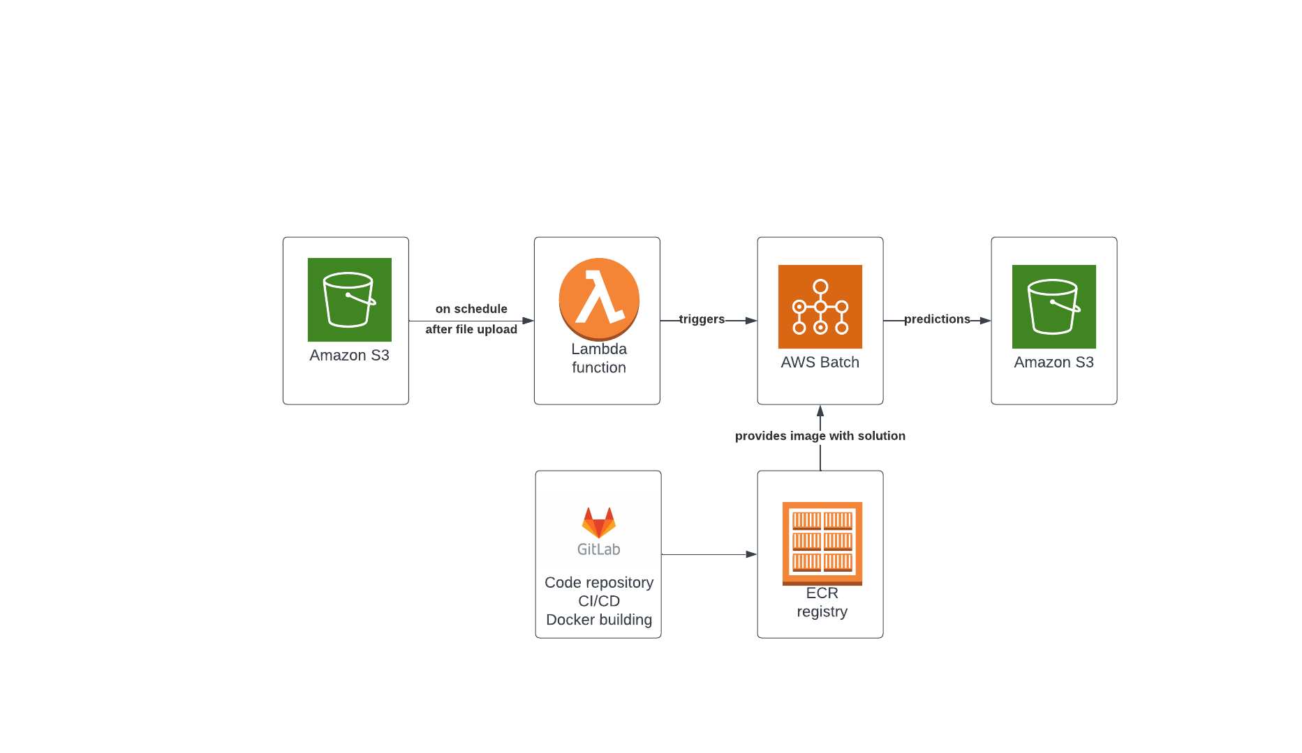
Architecture

Slide 9
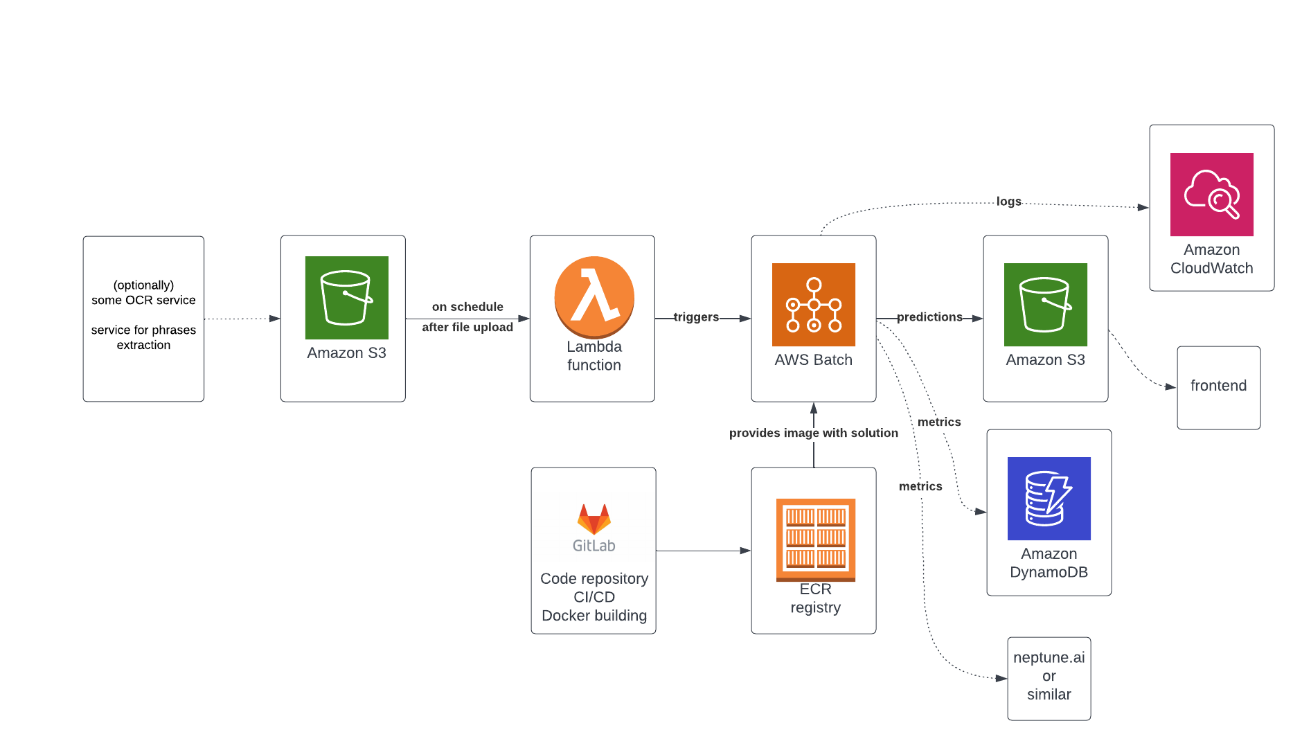
Architecture

Slide 10
Retraining, misc
EC2, Fargate
AWS CICD tools
Model explanations
Adversaries – not considered

Slide 11
Productionalization plan
Assumptions: POC code prepared, model went through experimentation phase and is ready to be operationalized
pipeline building (data engineering)
CI/CD setup w/development flow
code industrialization, ie: refactorization/modularization to achieve production-ready code, unit testing, logging, data import/export handling, data validation (sanity checks), building monitoring
testing
deployment (different possible strategies)
monitoring/retraining/testing…
documentation and service recovery strategies

Slide 12
What could go wrong in the long run once the model is deployed and used on live data?

Slide 13
What can go wrong?
ML monitoring:
input data can be missing column with sentences (data quality issue | sanity checks needed)
there is a sharp increase in negative assestments in EPARs (change data distr. |data drift monitoring needed)
... (model drift monitoring needed)
increase in amount of inference requests (throughput limitations, increasins costs | flexible architecture and cost monitoring needed)
sentence extraction mechanism provides wrong kind of sentences (data quality issue | data drift monitoring and scoring monitoring needed)
etc...

Slide 14
Productionalization - monitoring
ML monitoring:
input data (data quality problems, data distribution/data drift, outliers)
model monitoring (versioning, configuration, training metrics)
predictions (archiving predictions, evaluation of performance, model drift)
Other:
E2E pipeline monitoring
cost monitoring
Latency/throughput monitoring

Slide 15
What tools and methodologies would be helpful to maintain the model also in the long run?

Slide 16
Tools and methods for monitoring
Methods:
- code: data validation, metrics outputting and logging
- pipeline: alert mechanisms when error/warnings occur (AWS)
- error analysis
Tools:
- metrics gathering tool, ie. Neptune AI (not only results, but input data monitoring, performance etc)
- email notification for situation that require action
- logging
-

Slide 17
Metric | Input data / predictions | Sanity check / model monitoring

Slide 18
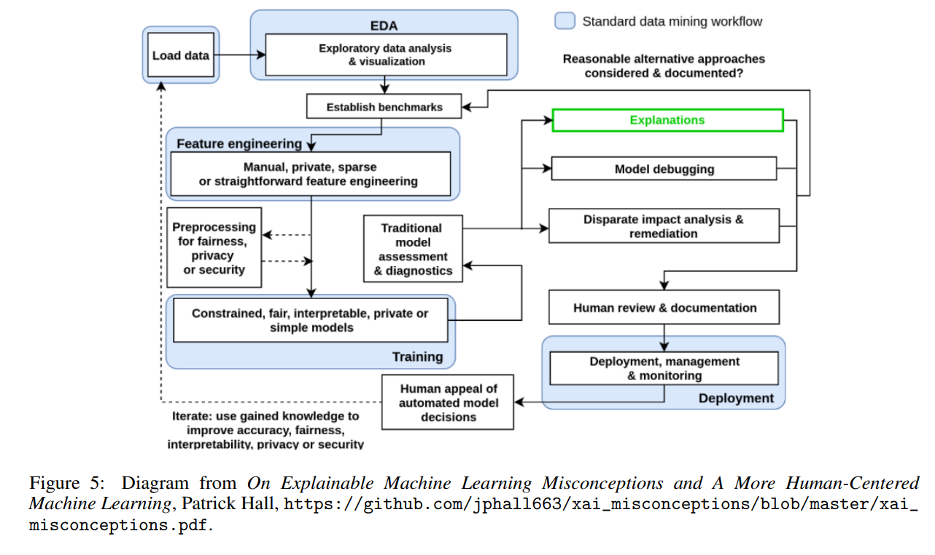
Different points of view...
arXiv:1907.04461v1 [cs.LG] 9 Jul 2019

Slide 19
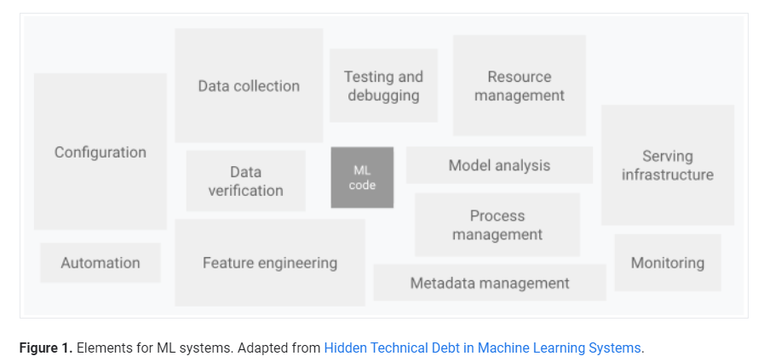
Different points of view...
https://cloud.google.com/architecture/mlops-continuous-delivery-and-automation-pipelines-in-machine-learning

Slide 20
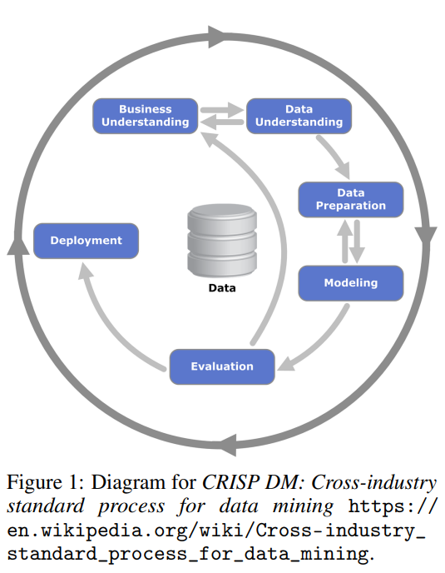
CRISP DM
arXiv:1907.04461v1 [cs.LG] 9 Jul 2019

